Slide 1

CSS
Lesson 7

Slide 2
CSS Dimension
Property | Description | Values
height | Sets the height of an element | auto length % inherit
max-height | Sets the maximum height of an element | none length % inherit
max-width | Sets the maximum width of an element | none length % inherit
min-height | Sets the minimum height of an element | length % inherit
min-width | Sets the minimum width of an element | length % inherit
width | Sets the width of an element | auto length % inherit

Slide 3
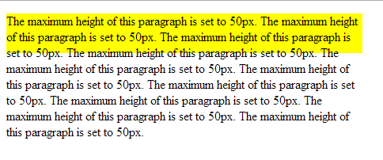
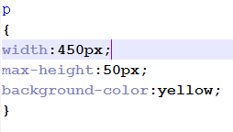
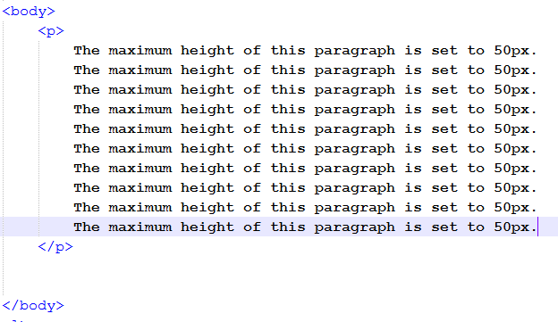
CSS Dimension
Max-height
style.css
doc.html

Slide 4
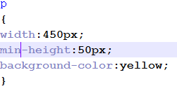

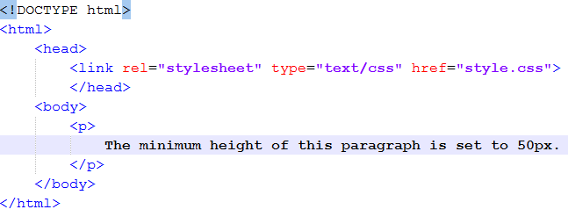
CSS Dimension
Min-height
style.css
doc.html

Slide 5
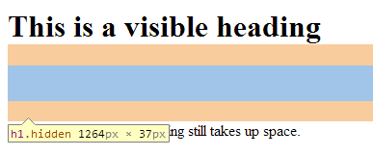

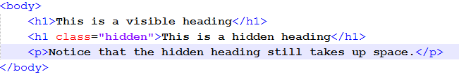
CSS Visibility
style.css
doc.html

Slide 6
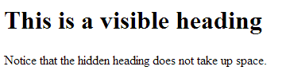

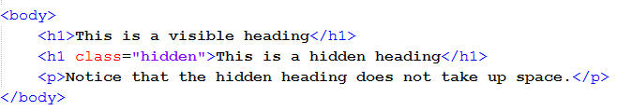
CSS Display
display: block | inline | inline-block | inline-table | list-item | none | table | table-caption | table-cell | table-column-group | table-column | table-footer-group | table-header-group | table-row | table-row-group|flex|inline-flex
style.css
doc.html

Slide 7

Task1:

